Slide 1


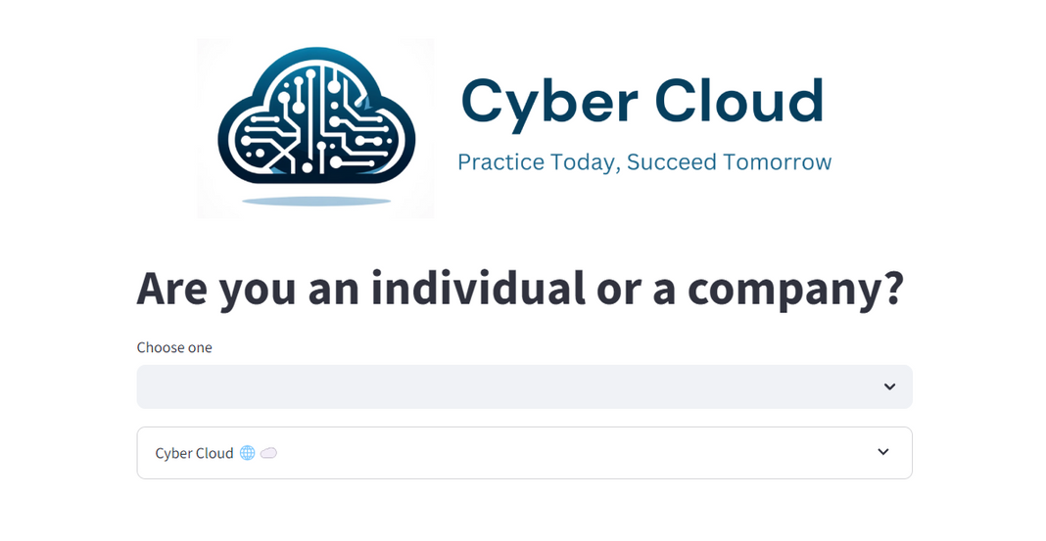

Automated Interview Process
Based on NLP and Computer Vision

Slide 2
Ahmed
Osama
Nour
Team
members
Image Verification
Resume Analyzer
Interview Bot
Nour Hossameldin Shamseldin Mohamed 4221290
Osama AlHussein AbdAljalil Elkassaby 4221147
Ahmed Saad Mohamed Ahmed Zidan 4221124
Designed the interview ensuring the integration of NLP and establishing a strong
foundation for future developments
Worked on verifying the suitability of images for CVS,
to ensure high quality, professional profile pictures.
Developed the core functionalities of the
resume analyzer, focusing
on key algorithms for
NLP and UI design.
Supervised by
Prof. Hisham Arafat Ali

Slide 3
Nour
Osama
Ahmed
Team
members
Resume Analyzer
Interview Bot
Image Verification
Nour Hossameldin Shamseldin Mohamed 4221290
Osama AlHussein AbdAljalil Elkassaby 4221147
Ahmed Saad Mohamed Ahmed Zidan 4221124
Developed the core functionalities of the
resume analyzer, focusing
on key algorithms for
NLP and UI design.
Designed the interview ensuring the integration of NLP and establishing a strong
foundation for future developments
Worked on verifying the suitability of images for CVS,
to ensure high quality, professional profile pictures.
Supervised by
Prof. Hisham Arafat Ali

Slide 4


Ahmed
Osama
Nour
Let's Tell a Story
Overview
Our project leverages advanced Natural Language Processing (NLP) and Computer Vision to enhance the job application process. The Resume Analyzer ensures ATS compliance and offers personalized job recommendations by identifying and correcting errors in resumes. The Interactive Interview Bot conducts mock interviews and provides detailed feedback, helping candidates prepare effectively. Our mission is to streamline the job application process and empower job seekers with the tools they need to succeed.
Image Verification
Resume Analyzer
Interview Bot
Designed the interview ensuring the integration of NLP and establishing a strong
foundation for future developments
Worked on verifying the suitability of images for CVS,
to ensure high quality, professional profile pictures.
Developed the core functionalities of the
resume analyzer, focusing
on key algorithms for
NLP and UI design.

Slide 5
Let's Tell a Story
Mohamed
Asmaa

Slide 6
I've sent my resume to so many companies and haven't gotten any replies

Slide 7

Is there something wrong with my resume? Am I missing some required skills?

Slide 8
I need to understand what I can improve in my resume to get a job opportunity.

Slide 9
Last time ,I've received so many resumes, but it's hard to manually check each one.

Slide 10
We need a faster and more effective way to filter candidates and find the best fit.

Slide 11
We don't have programmers in the company, so we need a simple and easy-to-use solution.

Slide 12
Lets search ...

Slide 13



Best tools for filtering resumes
Cyber Cloud
Resume Worded
Job filter

Slide 14
Best tools for filtering resumes
Cyber Cloud
Resume Worded
Job filter

Slide 15
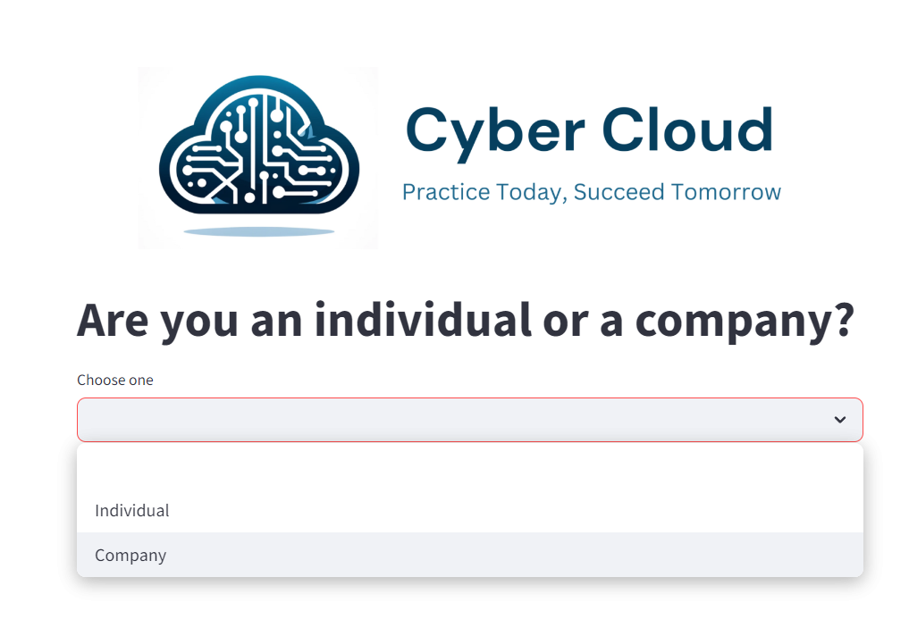
Introduction
تقدر تضغط وتختار أسماء ولا محمد

Slide 16
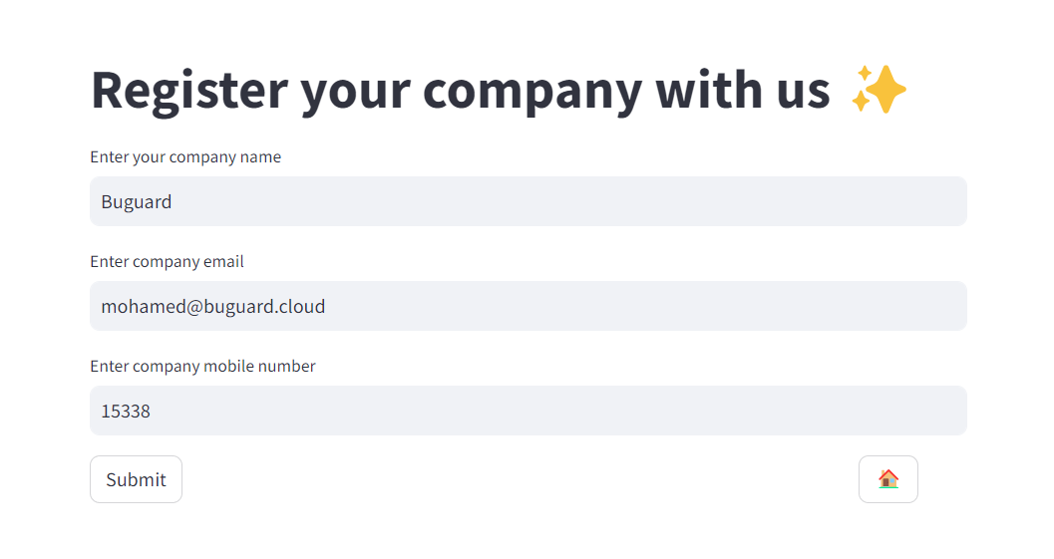
Introduction
تقدر تضغط وتختار أسماء ولا محمد

Slide 17
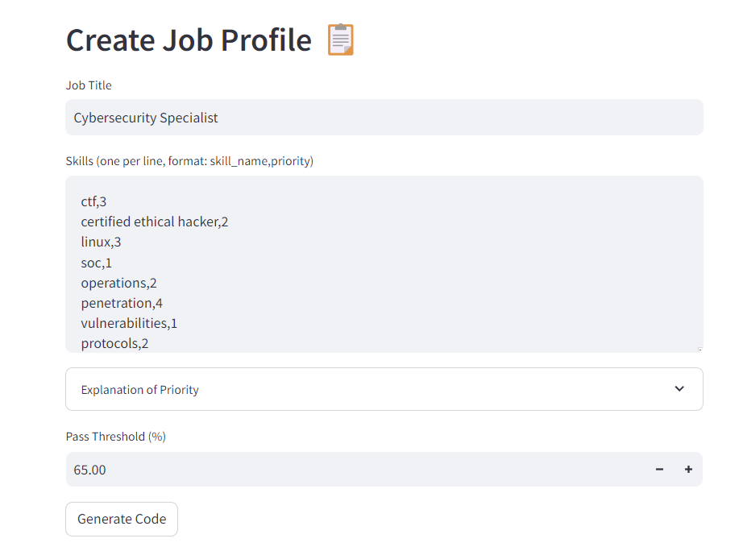
Introduction
تقدر تضغط وتختار أسماء ولا محمد

Slide 18
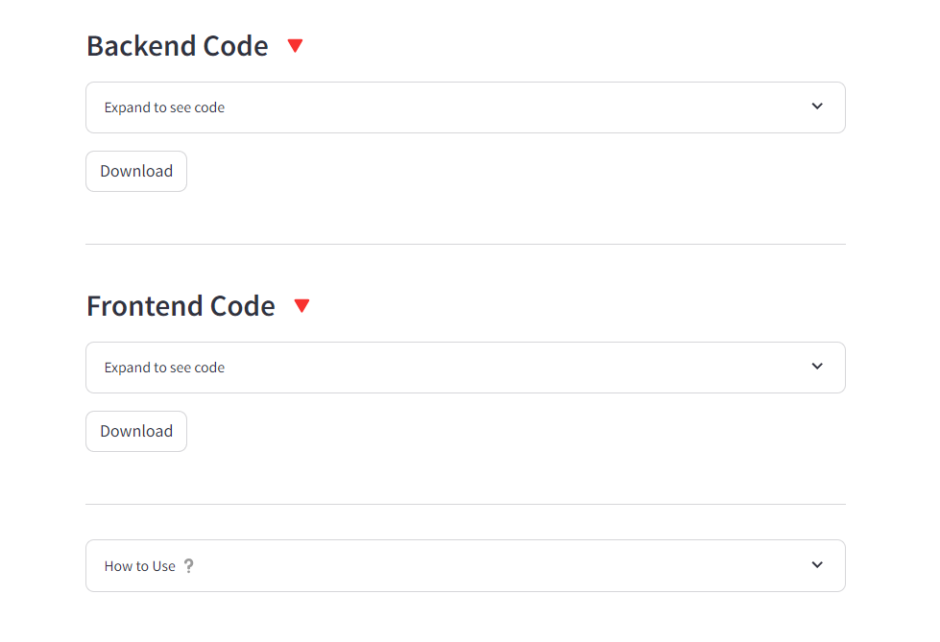
Introduction
تقدر تضغط وتختار أسماء ولا محمد

Slide 19
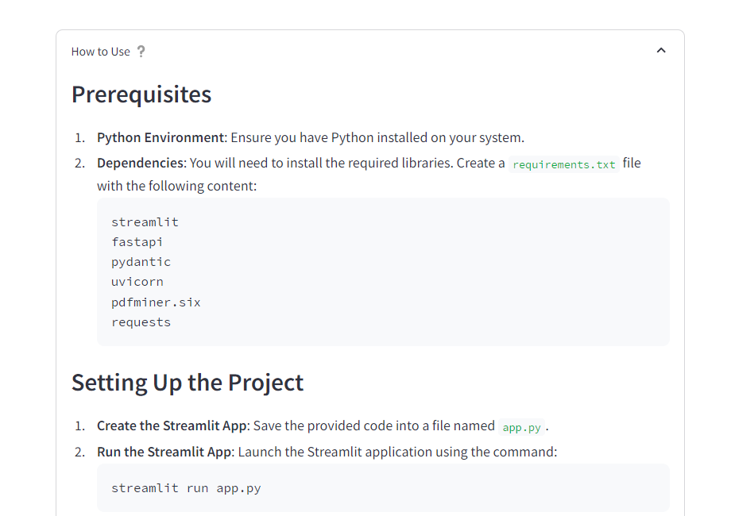
Introduction
تقدر تضغط وتختار أسماء ولا محمد

Slide 20
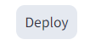
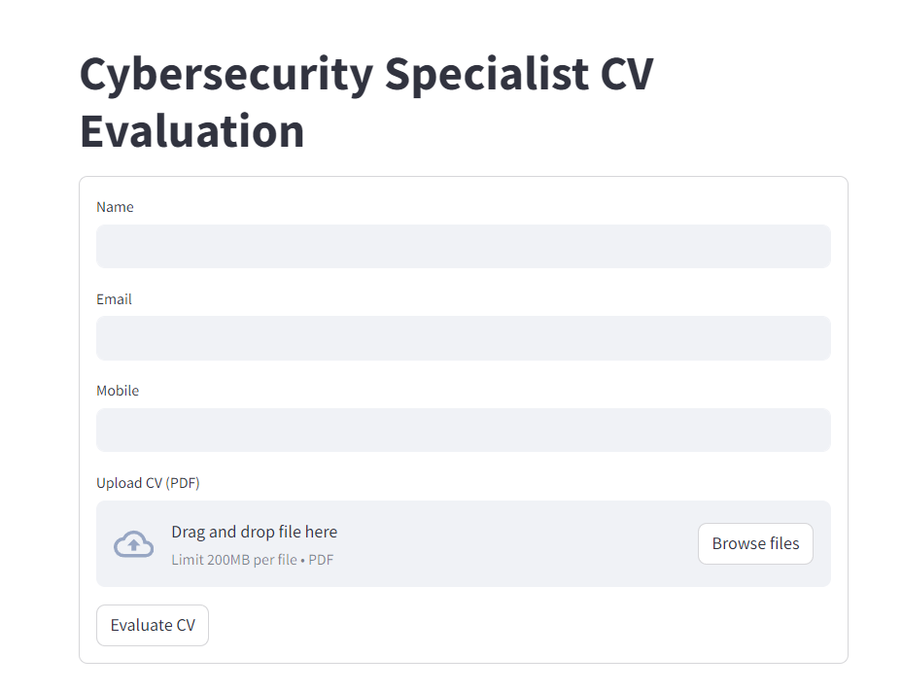
Introduction
تقدر تضغط وتختار أسماء ولا محمد

Slide 21
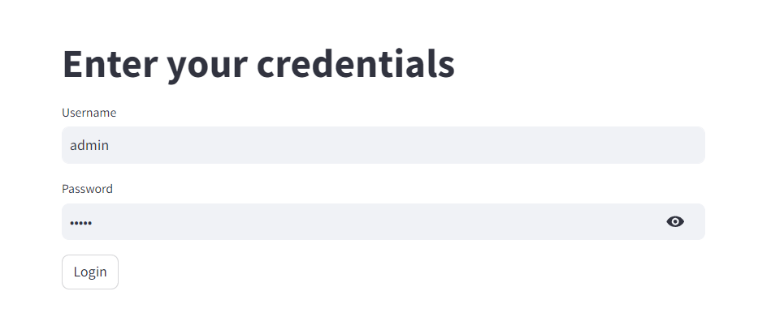
Introduction
تقدر تضغط وتختار أسماء ولا محمد

Slide 22
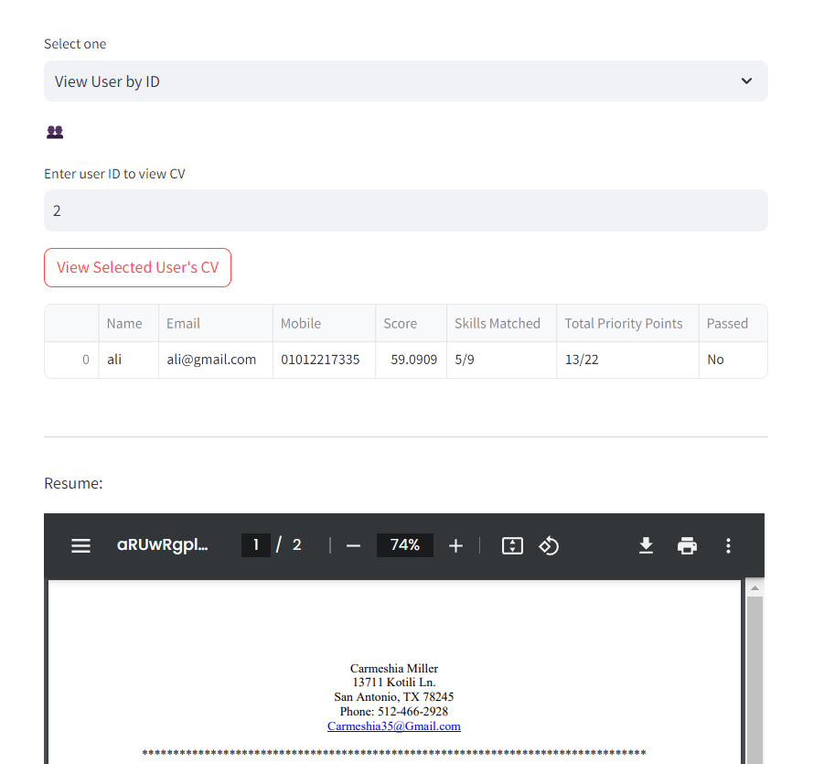
Introduction
تقدر تضغط وتختار أسماء ولا محمد

Slide 23
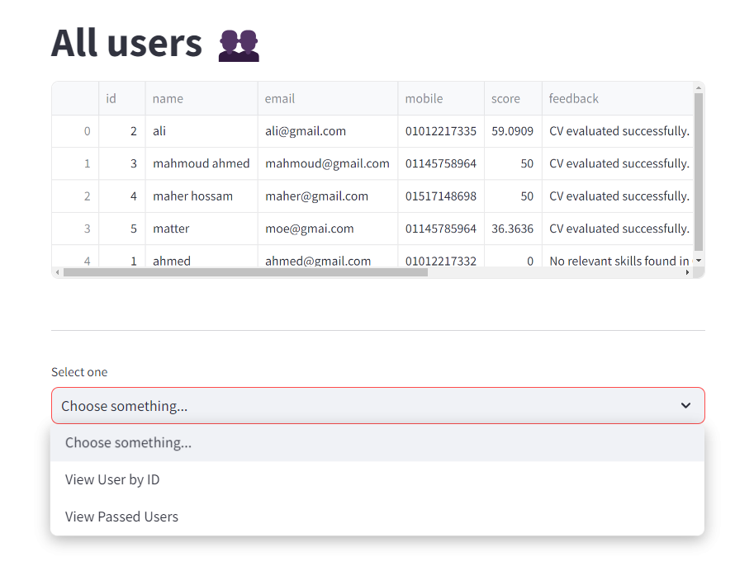
Introduction
تقدر تضغط وتختار أسماء ولا محمد

Slide 24
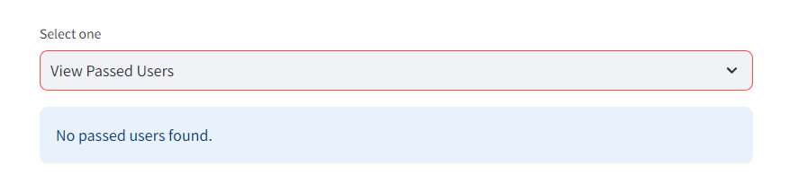
Introduction
تقدر تضغط وتختار أسماء ولا محمد

Slide 25
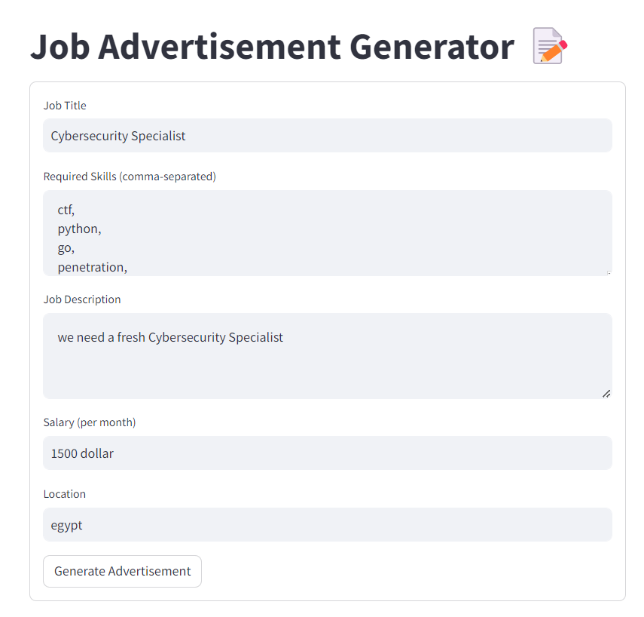
Introduction
تقدر تضغط وتختار أسماء ولا محمد

Slide 26
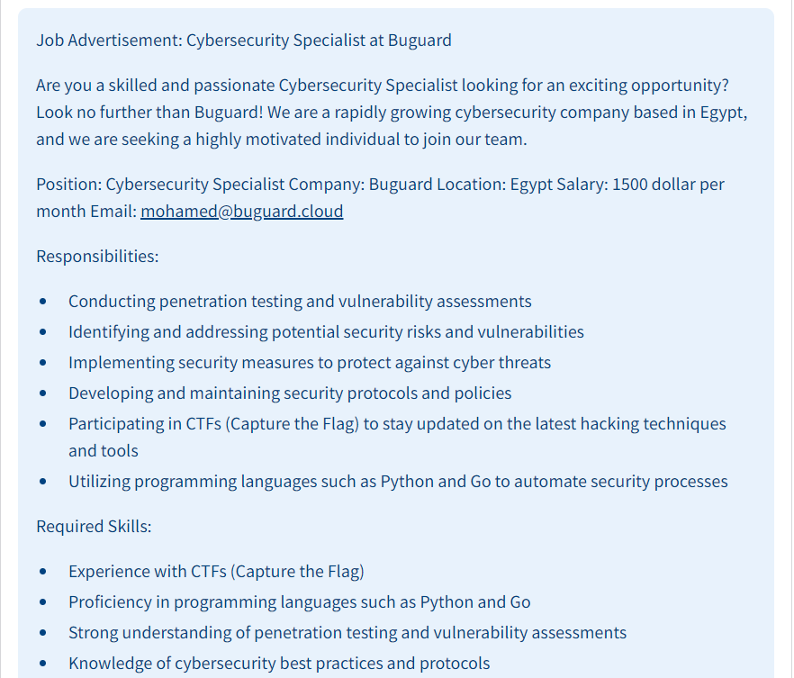
Introduction
تقدر تضغط وتختار أسماء ولا محمد

Slide 27
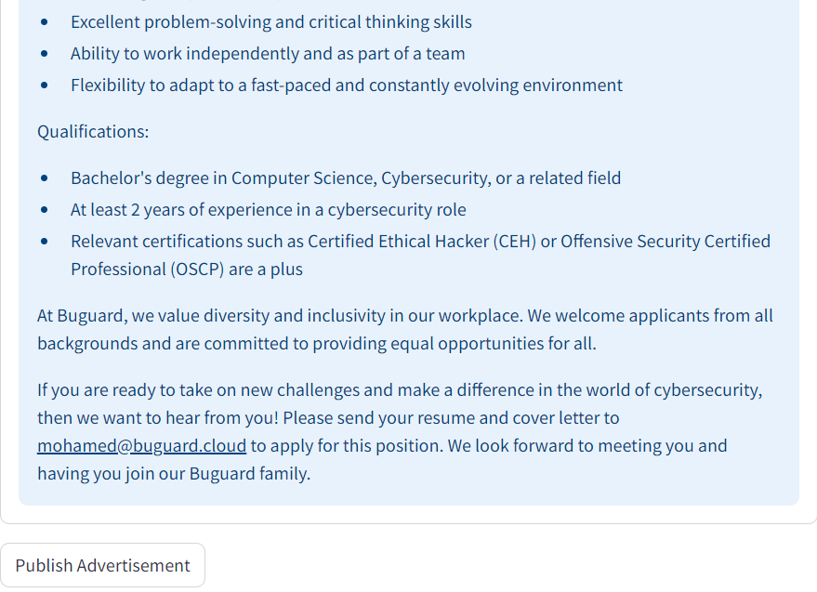
Introduction
تقدر تضغط وتختار أسماء ولا محمد

Slide 28
Finally, we've successfully posted the job ad on Cyber Cloud and created our custom site for filtering resumes. Now we can easily receive and sort applications, saving us a lot of time and effort.
I'm optimistic about finding the perfect candidate for this position soon.
Mohamed

Slide 29
Now it's my turn to tell you my experience after using the site.
Asmaa

Slide 30
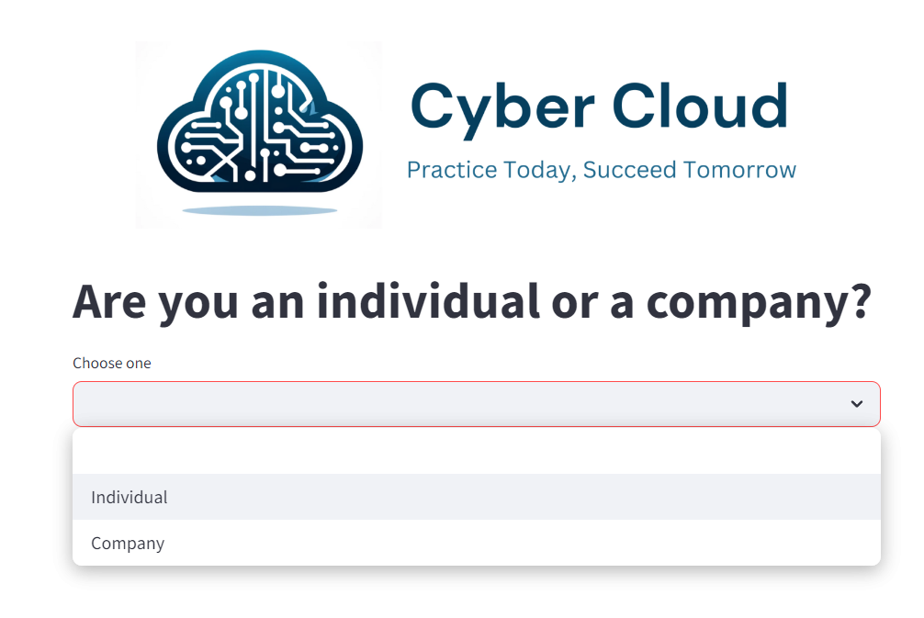
Introduction
تقدر تضغط وتختار أسماء ولا محمد

Slide 31
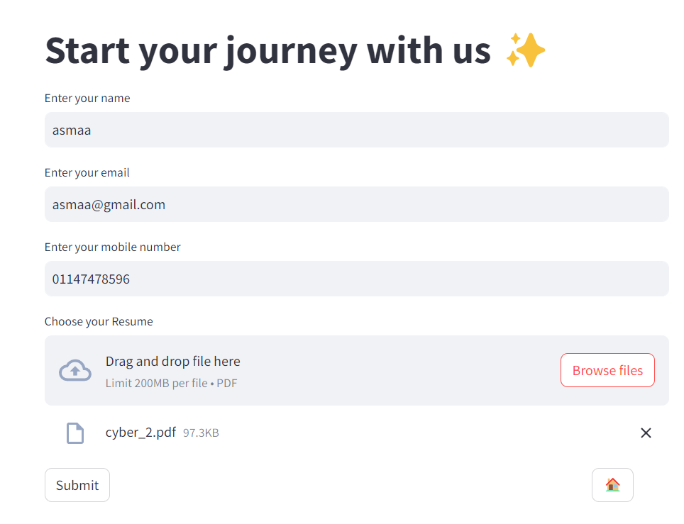
Introduction
تقدر تضغط وتختار أسماء ولا محمد

Slide 32
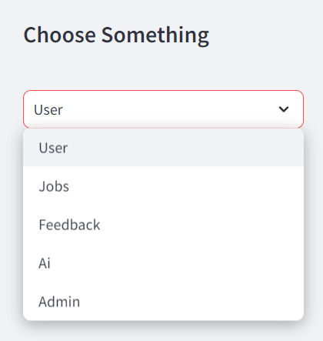
Introduction
تقدر تضغط وتختار أسماء ولا محمد

Slide 33
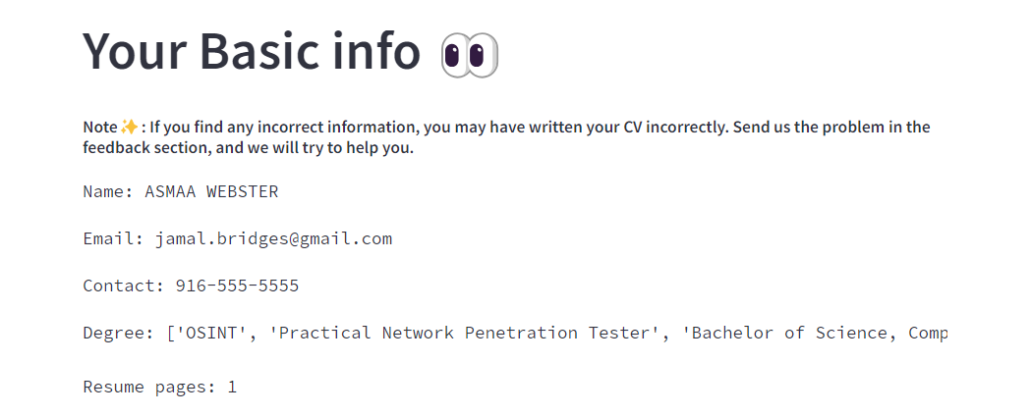
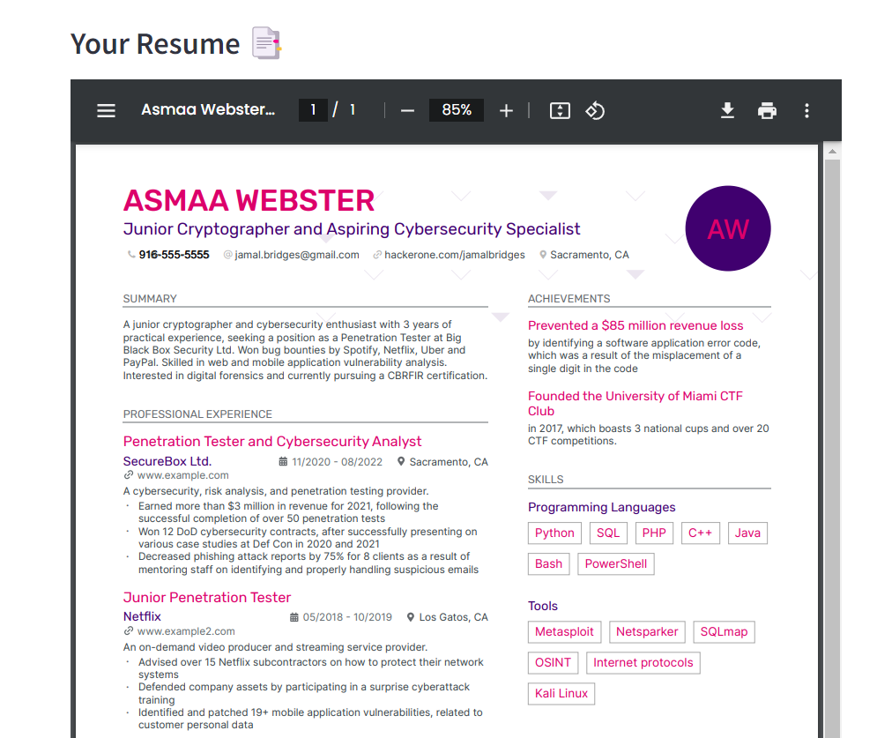
Introduction
تقدر تضغط وتختار أسماء ولا محمد

Slide 34
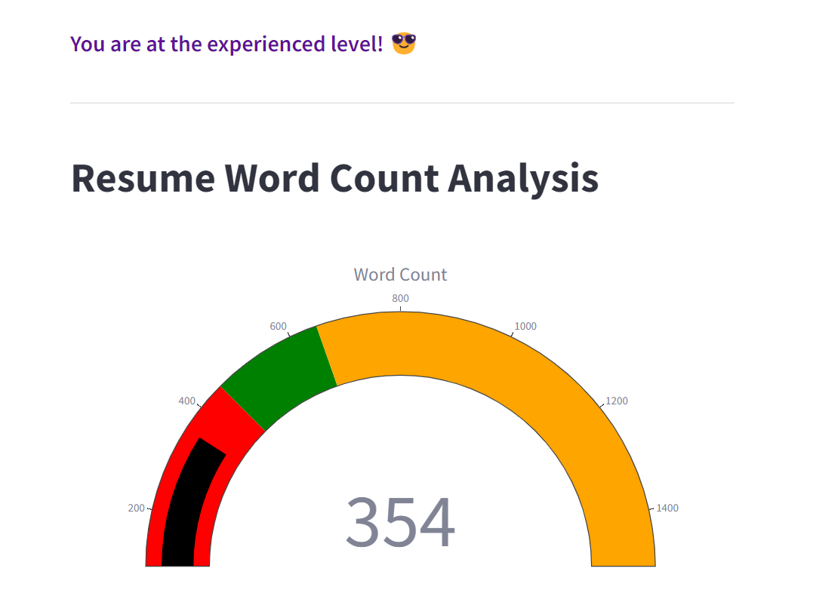
Introduction
تقدر تضغط وتختار أسماء ولا محمد

Slide 35
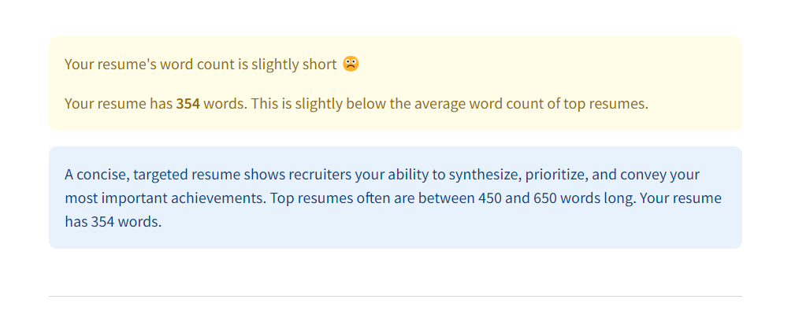
Introduction
تقدر تضغط وتختار أسماء ولا محمد

Slide 36
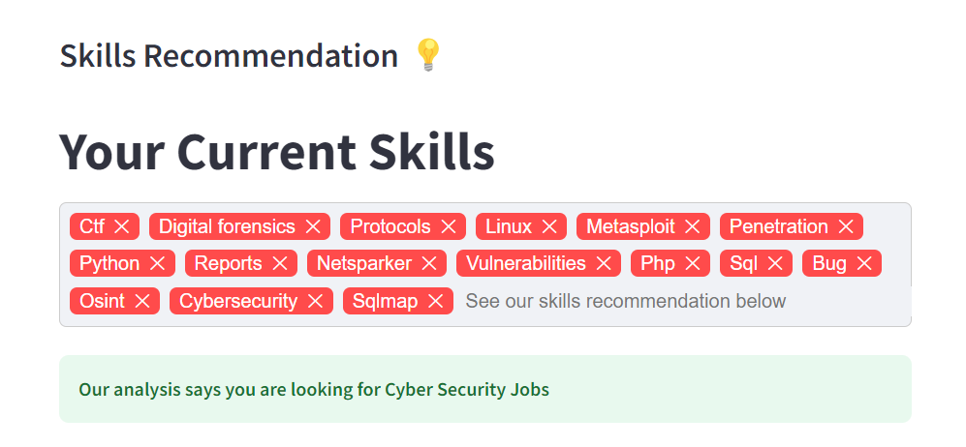
Introduction
تقدر تضغط وتختار أسماء ولا محمد

Slide 37
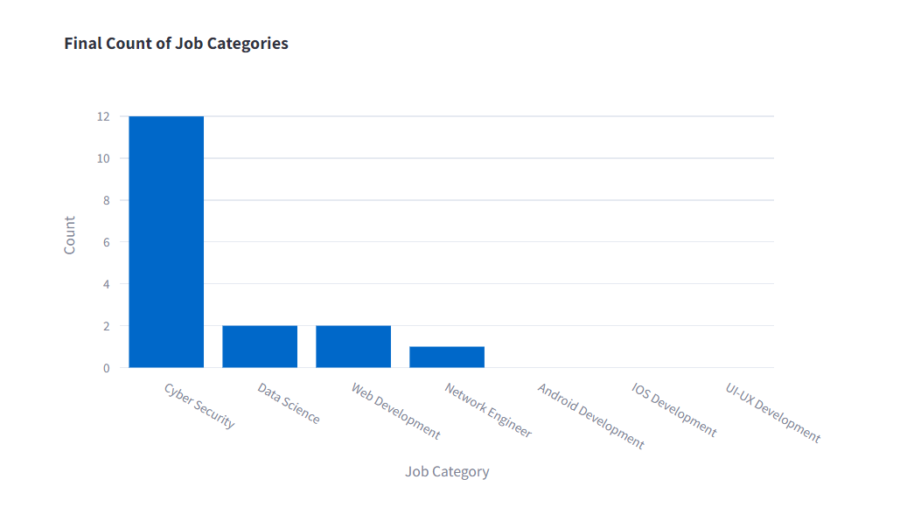
Introduction
تقدر تضغط وتختار أسماء ولا محمد

Slide 38
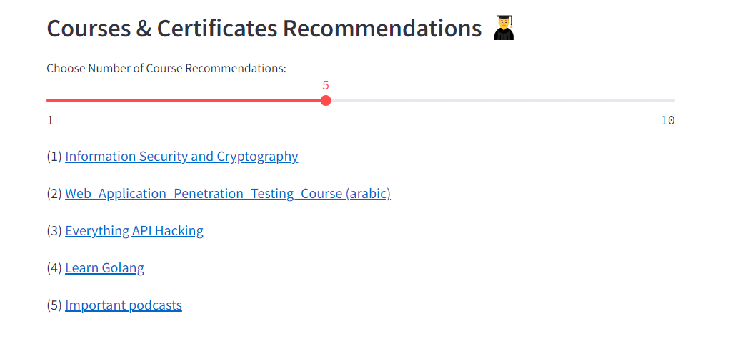
Introduction
تقدر تضغط وتختار أسماء ولا محمد

Slide 39
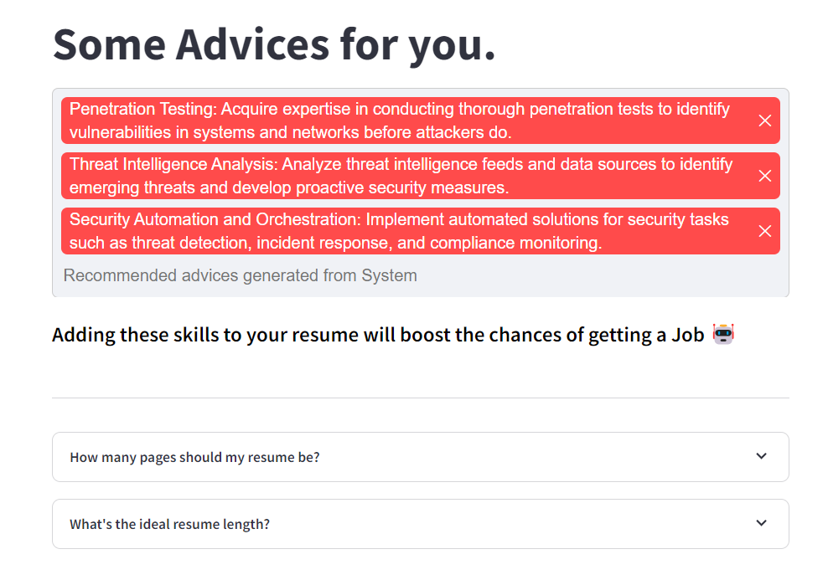
Introduction
تقدر تضغط وتختار أسماء ولا محمد

Slide 40
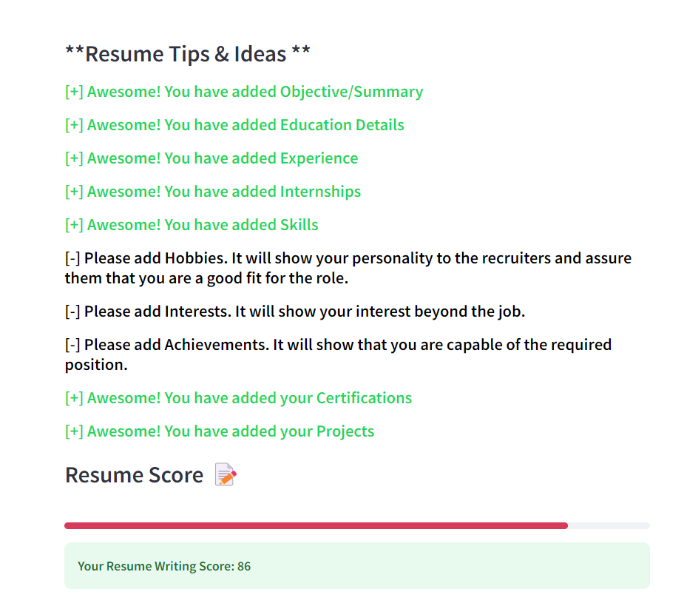
Introduction
تقدر تضغط وتختار أسماء ولا محمد

Slide 41
Introduction
تقدر تضغط وتختار أسماء ولا محمد

Slide 42
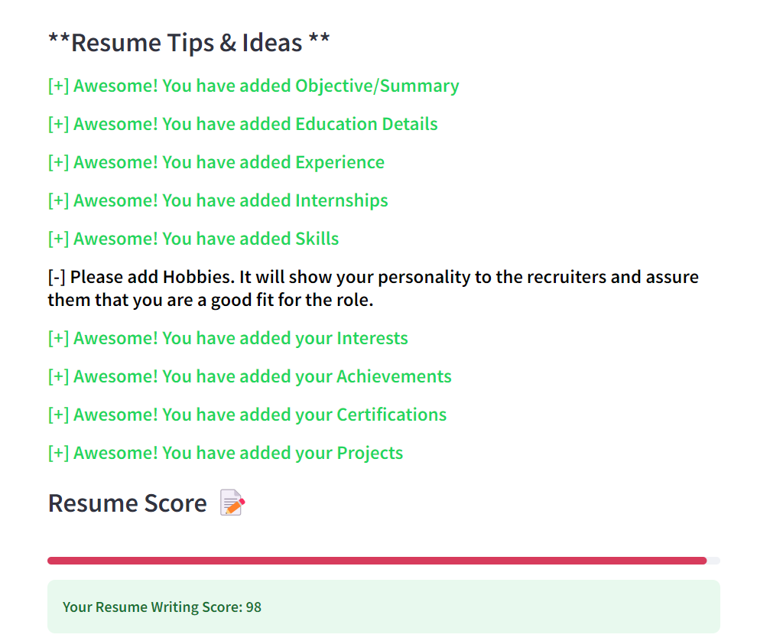
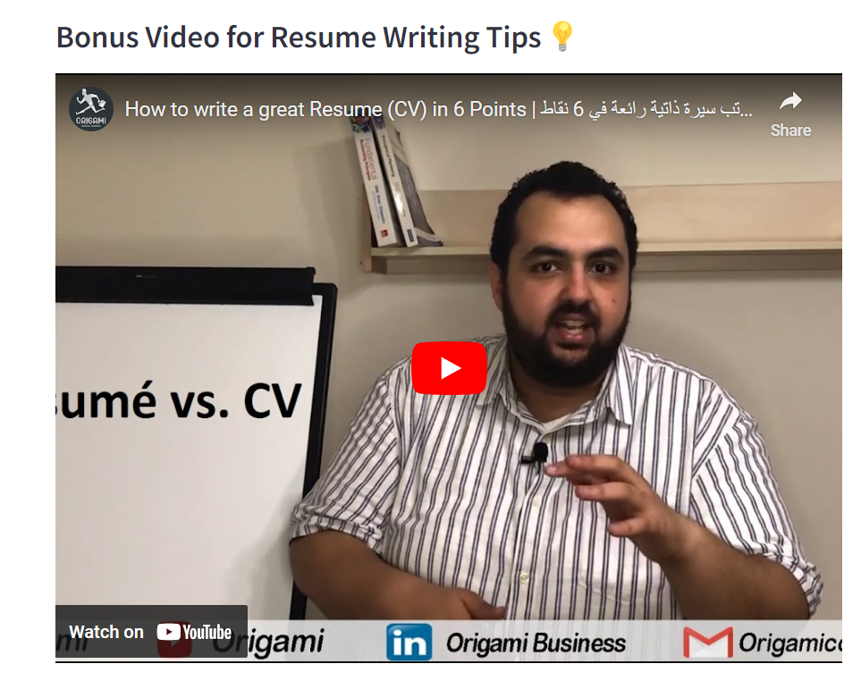
Introduction
تقدر تضغط وتختار أسماء ولا محمد

Slide 43
Introduction
تقدر تضغط وتختار أسماء ولا محمد

Slide 44
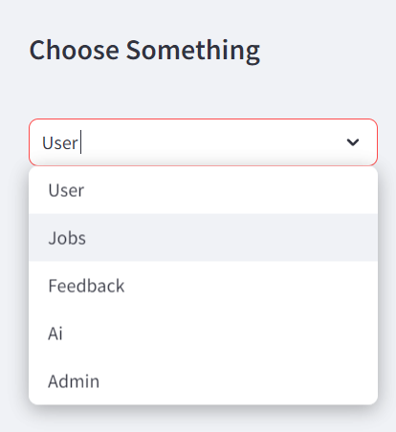

Slide 45
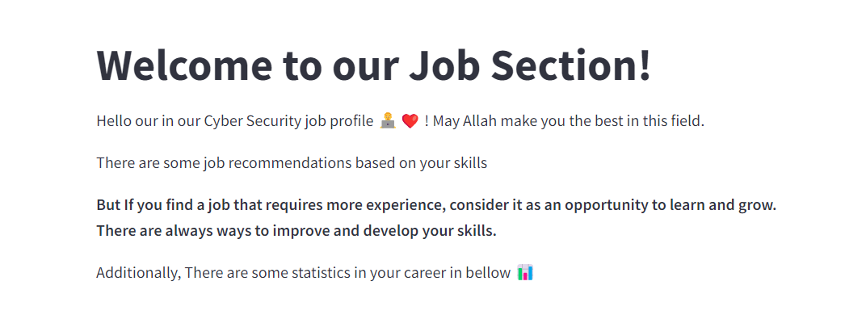
Introduction
تقدر تضغط وتختار أسماء ولا محمد

Slide 46
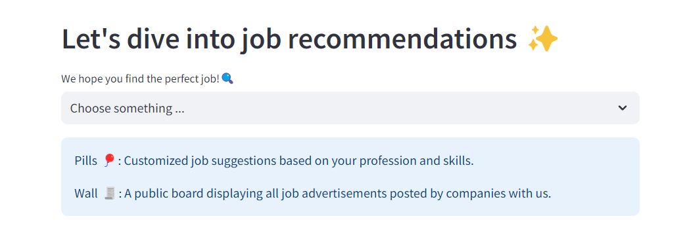
Introduction
تقدر تضغط وتختار أسماء ولا محمد

Slide 47
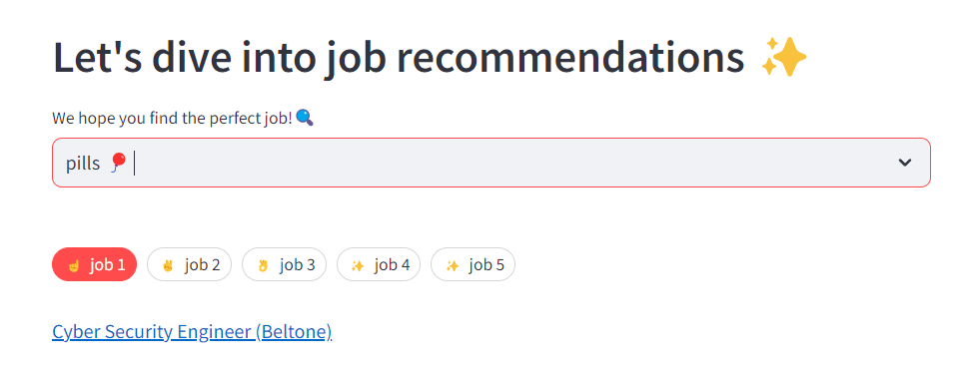
Introduction
تقدر تضغط وتختار أسماء ولا محمد

Slide 48
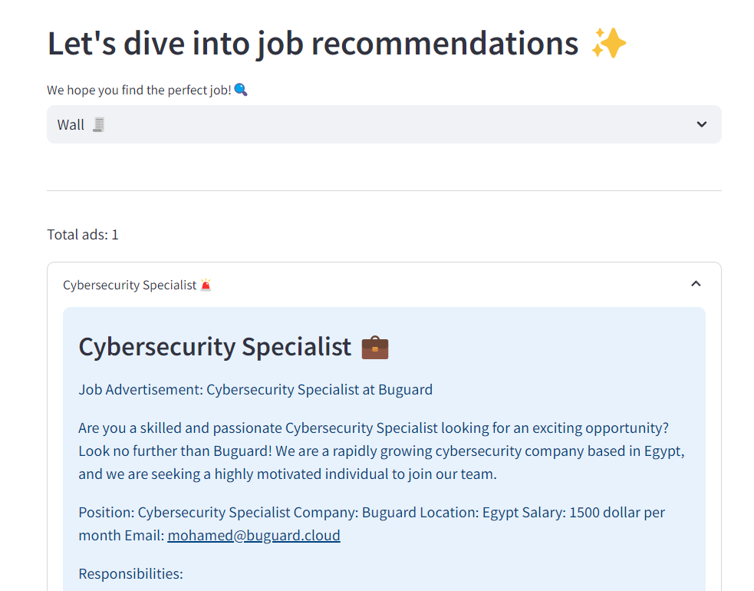

Introduction
تقدر تضغط وتختار أسماء ولا محمد
I think this job is good for me

Slide 49
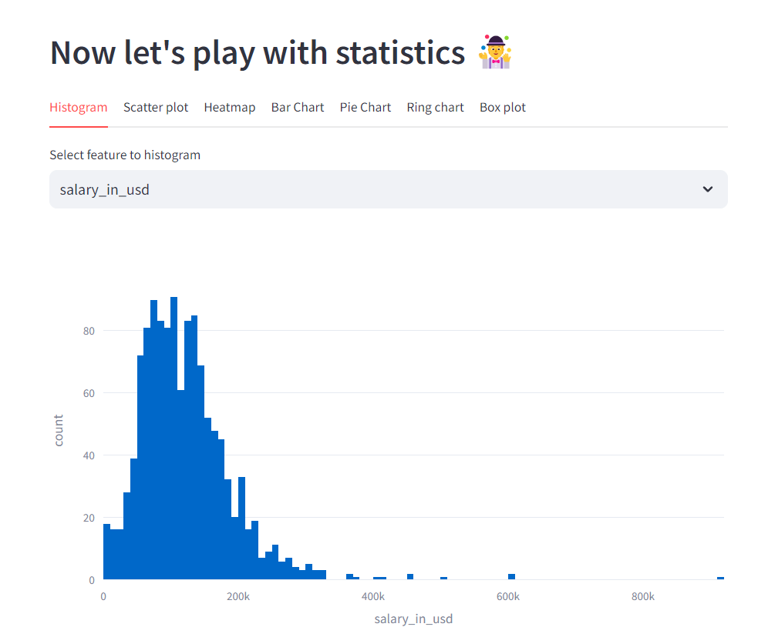
Introduction
تقدر تضغط وتختار أسماء ولا محمد

Slide 50
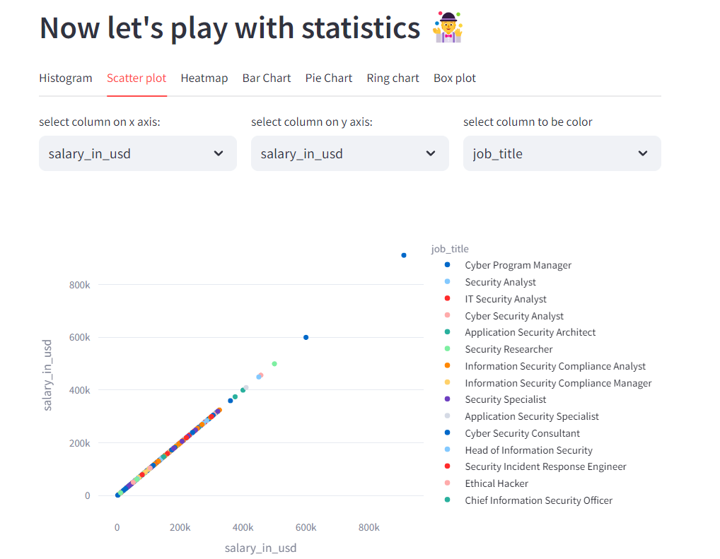
Introduction
تقدر تضغط وتختار أسماء ولا محمد

Slide 51
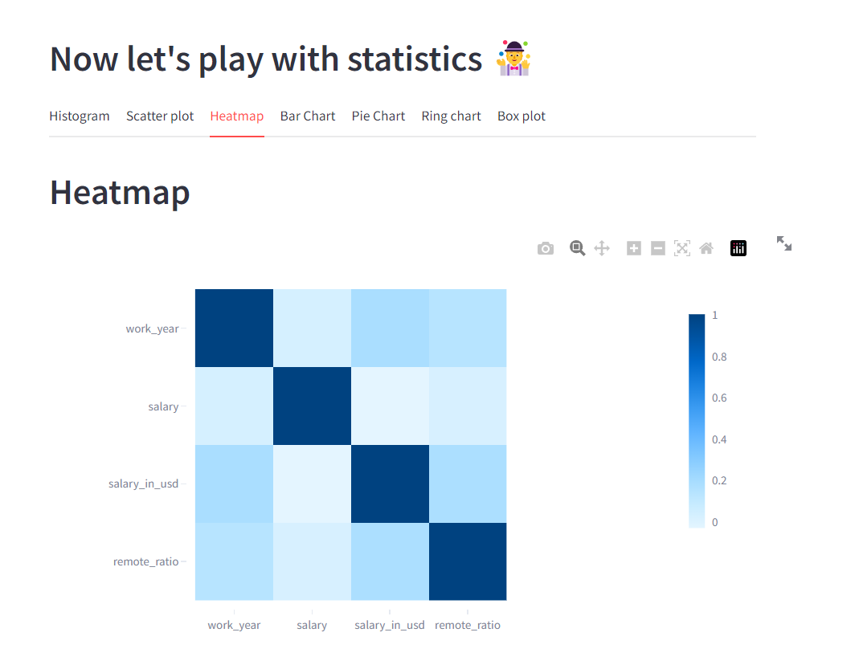
Introduction
تقدر تضغط وتختار أسماء ولا محمد

Slide 52
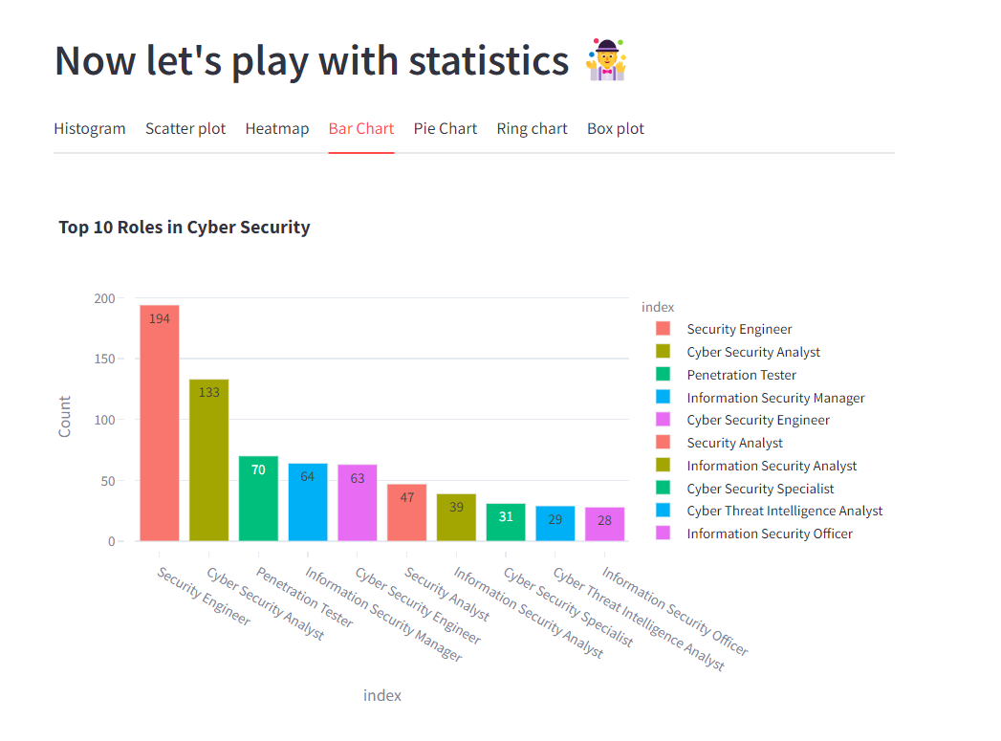
Introduction
تقدر تضغط وتختار أسماء ولا محمد

Slide 53
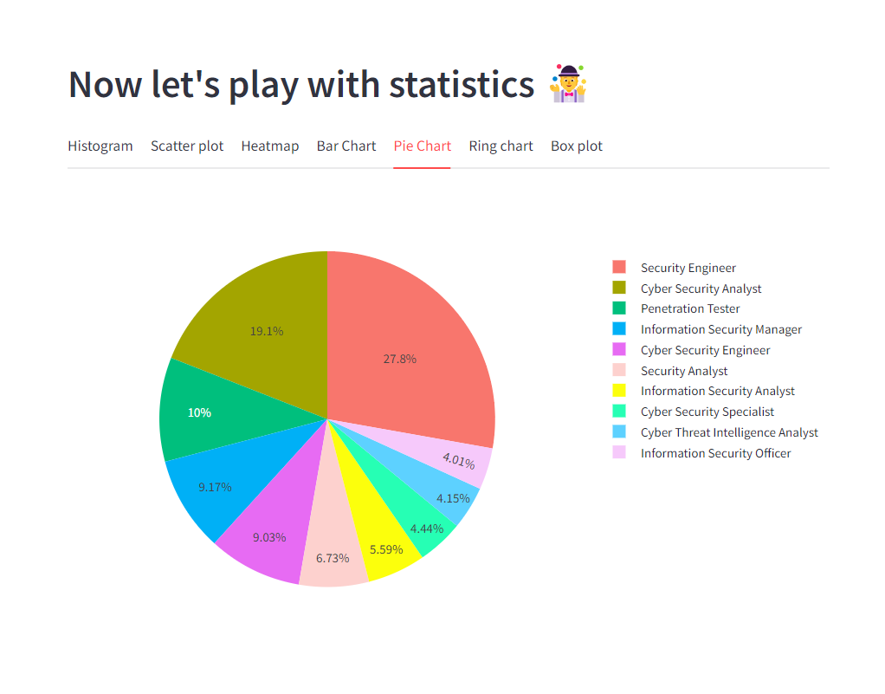
Introduction
تقدر تضغط وتختار أسماء ولا محمد

Slide 54
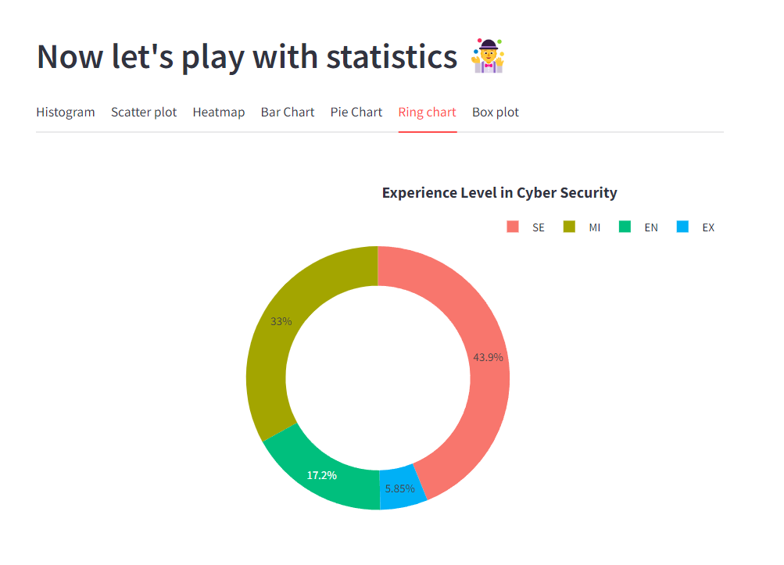
Introduction
تقدر تضغط وتختار أسماء ولا محمد

Slide 55
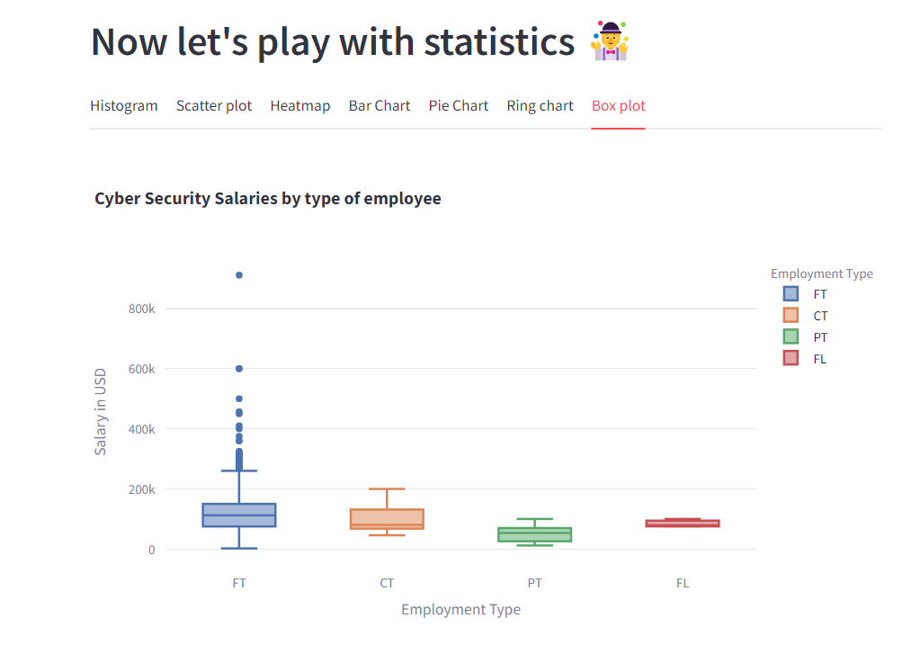
Introduction
تقدر تضغط وتختار أسماء ولا محمد

Slide 56
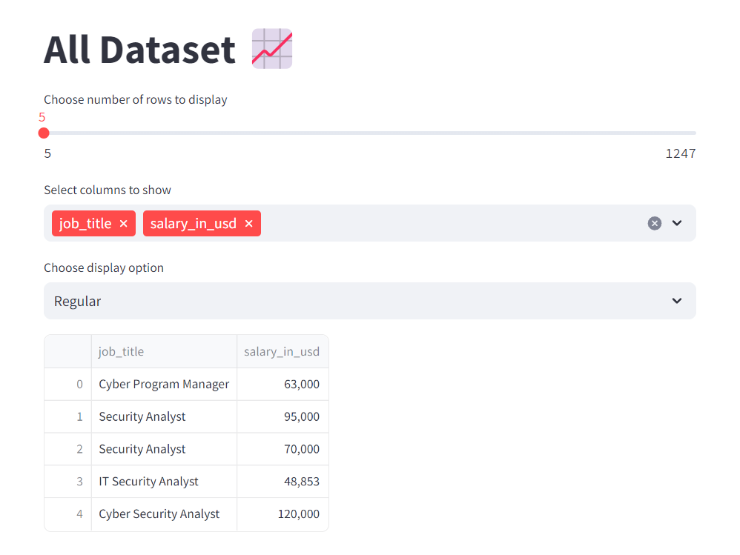
Introduction
تقدر تضغط وتختار أسماء ولا محمد

Slide 57
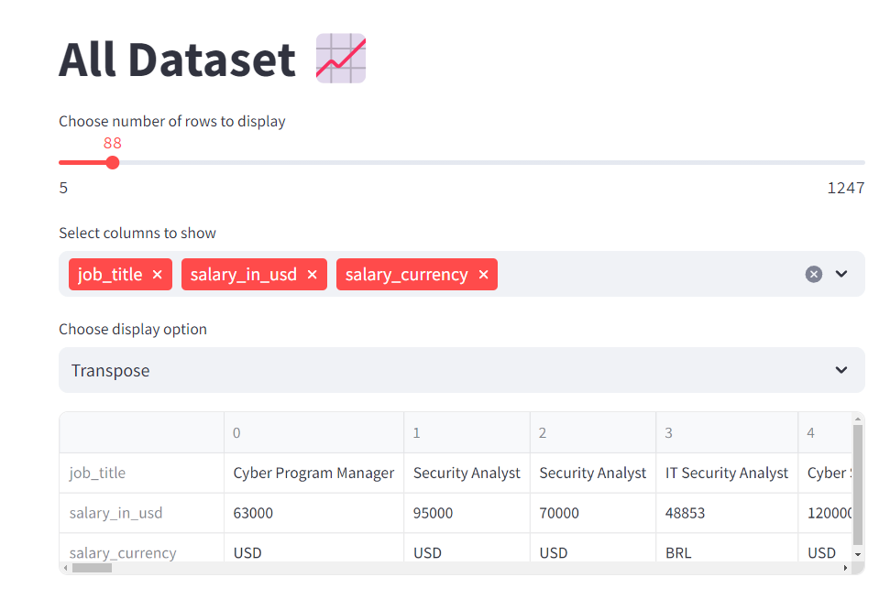
Introduction
تقدر تضغط وتختار أسماء ولا محمد

Slide 58
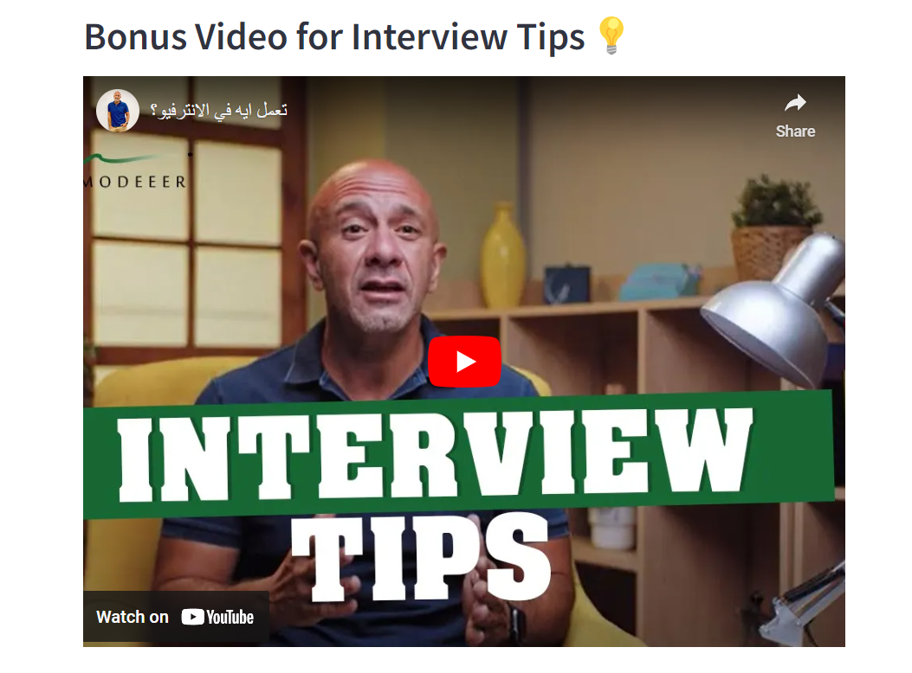
Introduction
تقدر تضغط وتختار أسماء ولا محمد

Slide 59
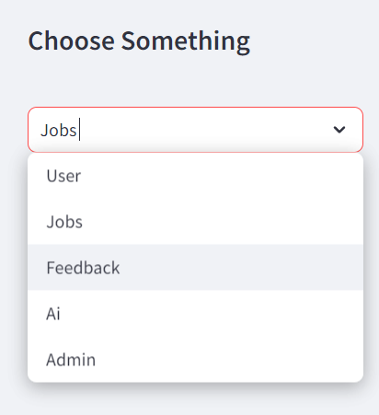
Introduction
تقدر تضغط وتختار أسماء ولا محمد

Slide 60
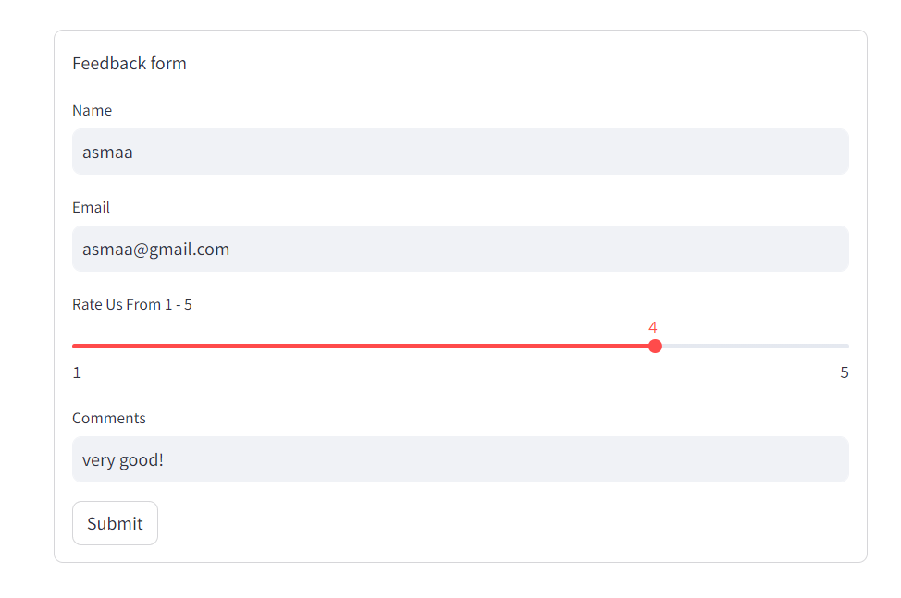
Introduction
تقدر تضغط وتختار أسماء ولا محمد

Slide 61
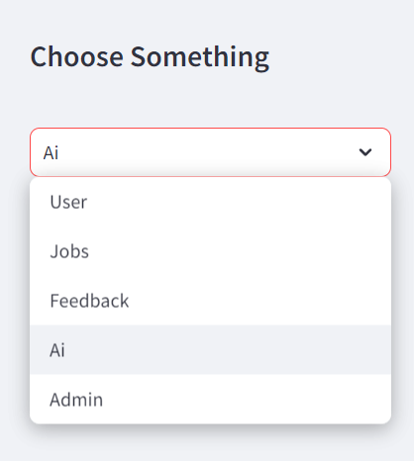
Introduction
تقدر تضغط وتختار أسماء ولا محمد

Slide 62
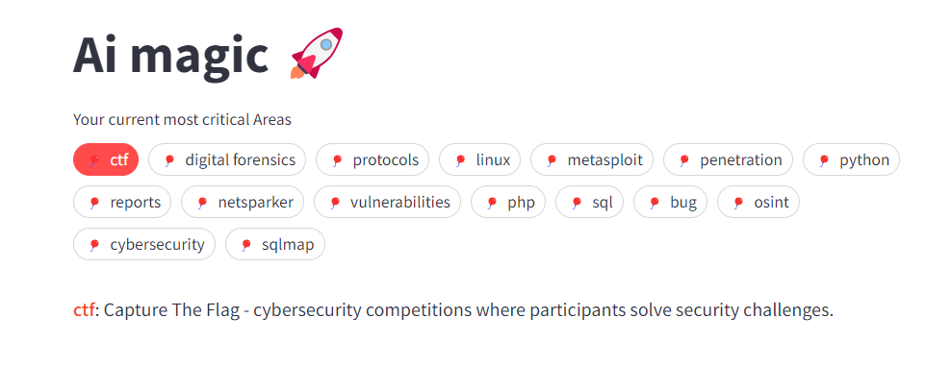
Introduction
تقدر تضغط وتختار أسماء ولا محمد

Slide 63
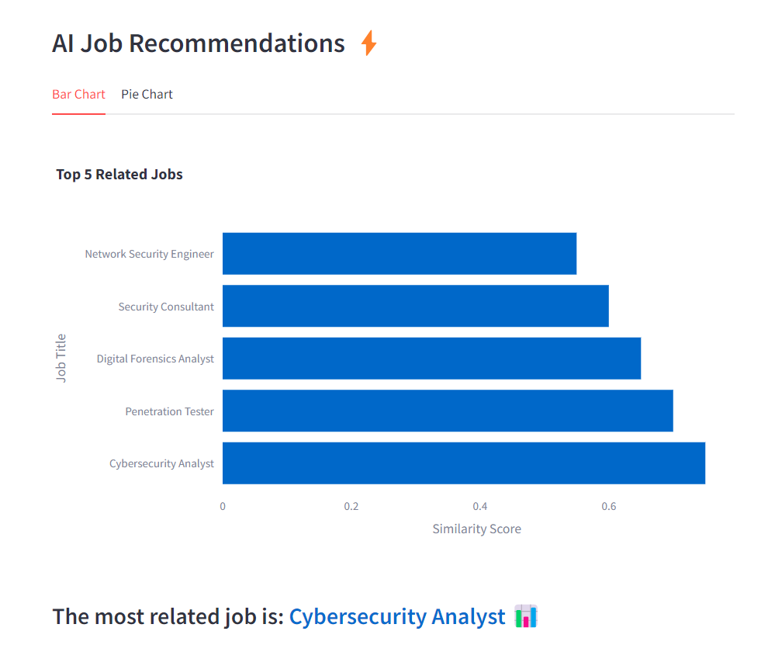
Introduction
تقدر تضغط وتختار أسماء ولا محمد

Slide 64
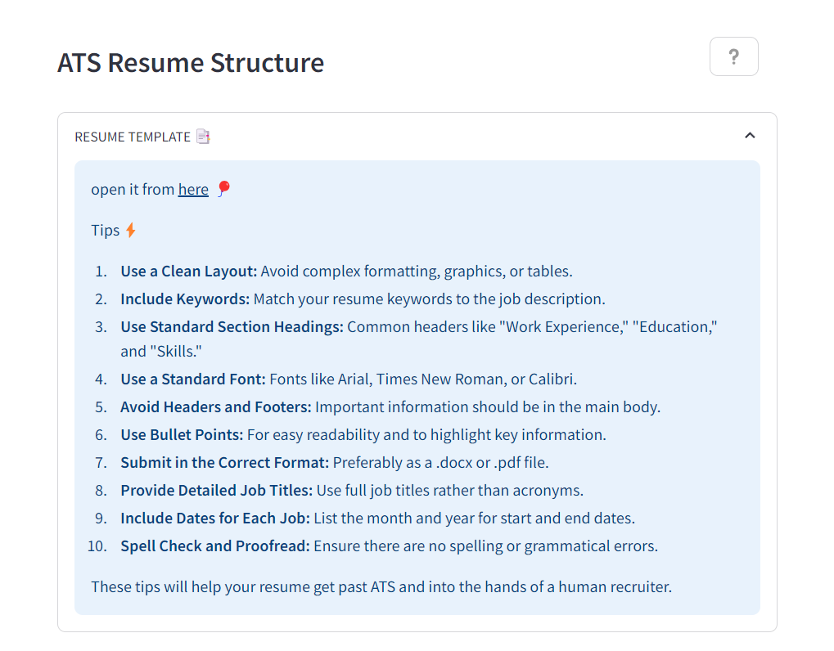
Introduction
تقدر تضغط وتختار أسماء ولا محمد

Slide 65

Introduction
تقدر تضغط وتختار أسماء ولا محمد

Slide 66

Introduction
تقدر تضغط وتختار أسماء ولا محمد

Slide 67

Introduction
تقدر تضغط وتختار أسماء ولا محمد

Slide 68

Introduction
تقدر تضغط وتختار أسماء ولا محمد

Slide 69

Introduction
تقدر تضغط وتختار أسماء ولا محمد

Slide 70

Introduction
تقدر تضغط وتختار أسماء ولا محمد

Slide 71

Introduction
تقدر تضغط وتختار أسماء ولا محمد

Slide 72


Slide 73



User's Data
Here, the admin can find the number of users and also see all the information about them.

Slide 74

User's Feedback Data

Slide 75

User Rating's
Chart Of User Rating Score From 1-5

Slide 76
More charts
A lot of Charts like (User's Experienced Level)

Slide 77
Manage Advertisements

Slide 78

I have updated my CV based on cyber cloud recommendations

Slide 79

I'm happy now and waiting for job opportunities

Slide 80

I've reviewed numerous candidates, but Asmaa stands out

Slide 81
I believe she's a perfect fit for the position we're offering. I'll send her an email to invite her for an interview

Slide 82


Slide 83

I may seem ordinary to you, but in reality, I am experiencing a mix of emotions.

Slide 84

feel excited because I received a job offer

Slide 85
but at the same time, I am nervous and not used to doing interviews

Slide 86
But Cyber Cloud has a solution: they offer mock interviews to help me practice ,
So let’s try it

Slide 87
I just needed to record my information first, then select the suitable job. After that, I started the chatbot. I can talk to it and also send it voice messages, and it can read the questions aloud.

Slide 88


Slide 89

And now look where I am

Slide 90

Demo Time

